Slide 1
Medical ED Using GNNs
SIGMOD/PODS ‘21(ACM)☹

Slide 2
Idea
Matching structural similarity utilizing GNN & KB info augmentation.
Over any basic graph NN , EDGNN adds two optimizations namely:
1.Query graph –A graph which is augmented from KG based on type similarity and exact matching . For Node Type , Gqry relies on NER task.
2.Sampling strategy for Hard negative mining (semantic/Structural dissimilarity score )

Slide 3
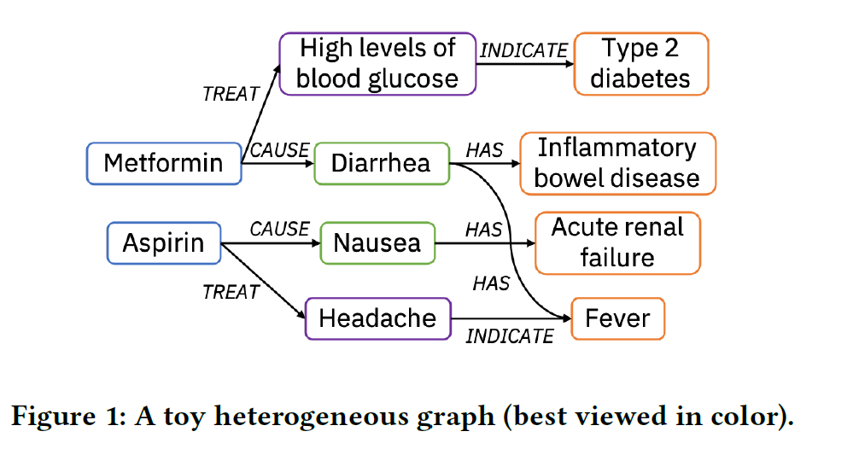
A sample Gref (kb) constructed from KB using mapping functions.

Slide 4
Construction of Query graph
There are two scenario for a node in query graph: It finds its exact match in Gref or it dosen't.
In first case exact matching is done to find nodes and edge relationship type and augment to Gqry.
In second case type matching with type set is done first for nodes and then edge type is detected .
Both GNN should be of same choice.
Gqry is constructed for some text snippet & Gref is for KB.

Slide 5
Augmentation algorithm
Graphs is passed to GNN in form of :
A node list, each row contains a node id, its attribute features, and its type.
An edge list, each row has a source node id (head), a destination node id (tail), and the edge type.

Slide 6
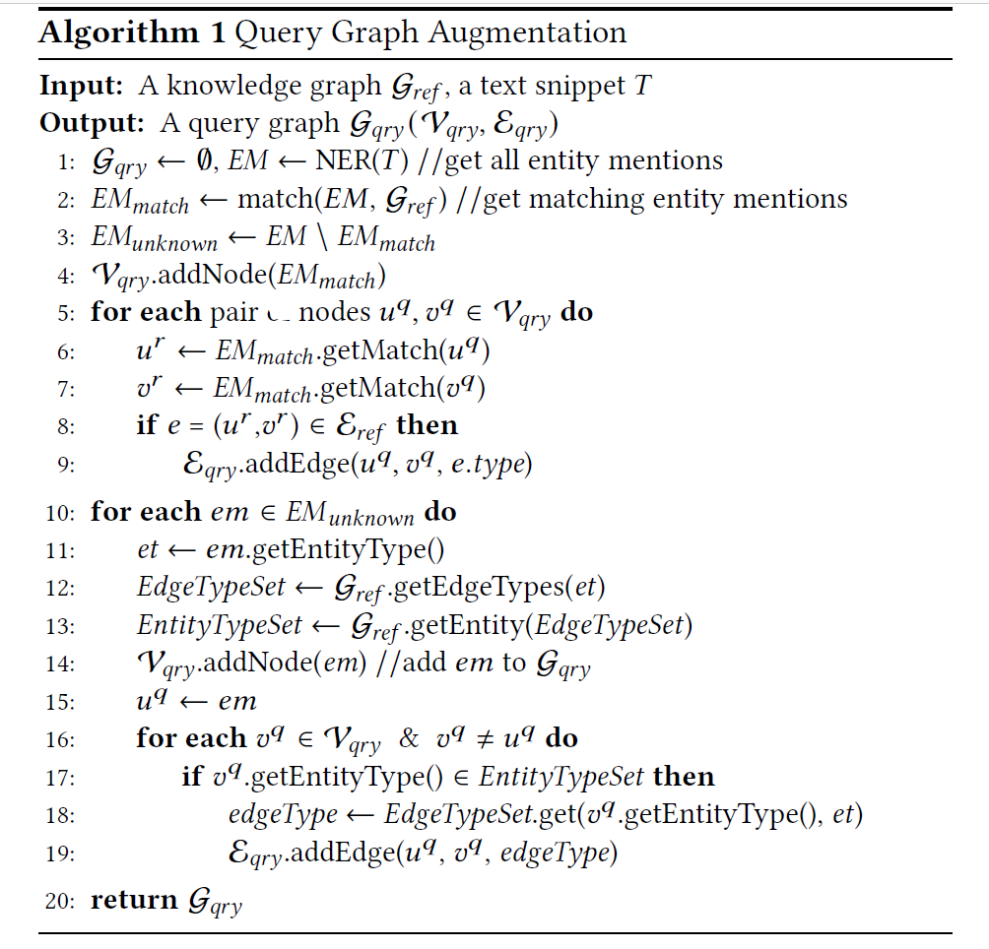
Algorithm:

Slide 7
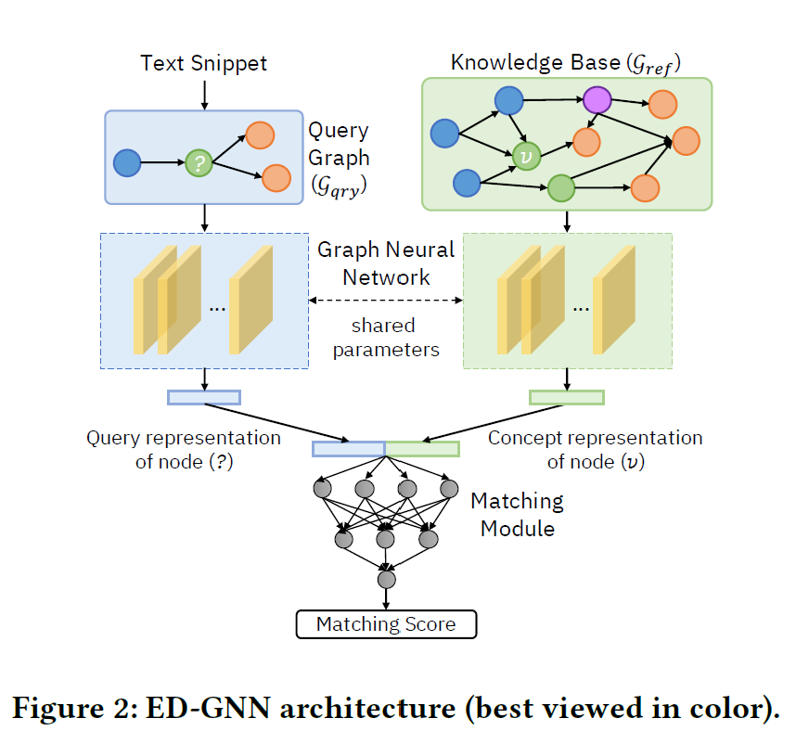
Model and Training

Slide 8
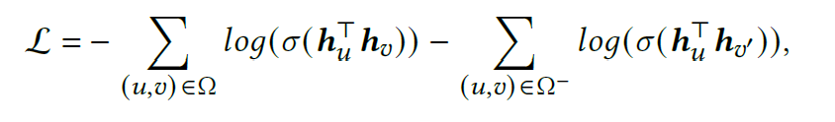
Training
Loss function :
Pairs are combination of ambiguos mention with its correct and hard negative.
The matching module can be a multi-layer perceptron with one hidden layer, a log-bilinear model, or simply a dot product.
For hard negative , semantic close or structurally close over 1 hop negatives are poisoned.
Back propagation to optimize embeddings.

Slide 9
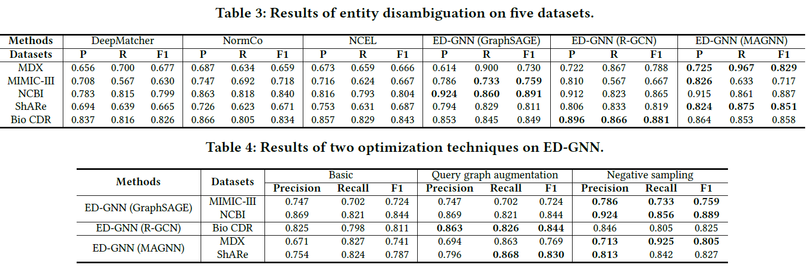
Results

Slide 10
observations
EDGNN based on GNN such as RSAGE , RGCN or MAGNN.
16.4% in f1 score.
Low complexity & high semantic richness is seen on NCBI dataset so Model performs well . Also dense structural relationship can inhibits the performance. MagNN handles this scenario well.
Almost 50% of the errors are due to a lack of graph structural information from text snippets

Slide 11
GNN details
R-sage – seminal message passing .By using node description etc. learns node embeddings are topological structure of graph.
RGCN – relation aware GCN .unlike R-sage ,which considers only nodewise connectivity , it considers also edge labels .In kth layer normalized sum of neighbour nodes is used to update matrix .Different edge type different weights.
Mag-NN – Metapath based GNN . For a node . Different Metapaths on to a node are considered .Uses attention to assign weight to each Metapath.

